Slide 1
Green Jobs – overview
Autumn 23 update
Data covering 2022 – 2023 (to date)

Slide 2
Green skills
Green skills not easily definable – combination of hard and soft skills – an umbrella term for technical skills, knowledge, behaviours and capabilities
Still not entirely possible to precisely predict which jobs will be created in the pursuit of decarbonisation, or what specific skills will be needed. However, the scale and nature of the future transformation in the UK’s workforce is starting to become visible
Irrespective of exact composition of UK’s future energy mix, net zero is likely to require two specific groups of skills:
1) The transition to clean energy is likely to require significant numbers of people trained in high level science, technology, engineering and maths (STEM) skills, such as environmental scientists and engineers
2) The process of decarbonising existing industry and assets will require a sizable workforce with strong low and medium level technical qualifications, such as retrofit installers
On this basis, the UK labour market is not well adapted for the transition, suffering from both low levels of STEM graduates and a relative lower supply of relevant vocational skills
This leaves a qualification gap at both the specialist and operational ends of the skills spectrum. The green jobs challenge is therefore not just a low skill retraining challenge or a high skill innovation challenge
Workers that currently make up carbon intensive industries are typically older. But the jobs that will replace them - turbine or battery manufacture, for example - are perceived as being for younger generations

Slide 3
Green skills
Some of the specific issues identified are:
- To fulfil the 2030 carbon target, estimated the UK needs 170,000 more workers to qualify per year than currently in areas such domestic retrofit, renewable heat and EV manufacturing and infrastructure
- In addition, more than 3 million people are in need of upskilling for the transition to net zero emissions
- Apprenticeships are a key route into these industries, but currently there are few routes available. There is also a severe gender imbalance in these industries
- The UK needs to bolster its domestic engineering capability to achieve net zero
- The list of free qualifications under the Lifetime Skills Guarantee fails to include crucial training for the net zero transition, such as domestic retrofit and electric vehicle engineering
Whilst these supply-side issues exist, the demand for green skills continues to grow strongly. Some estimates are that demand is growing by double-digit per year
Four possible major influences on market for green jobs and green skills
1) Expansion of skills and scope in existing specialist roles e.g. sustainability managers
2) Increased need for green skills in non-specialist roles e.g. product designer
3) Transition of workforce from less sustainable sectors to new roles e.g. vehicle assembly technician
4) Demand for green skills in new green sectors e.g. hydrogen plant operative

Slide 4
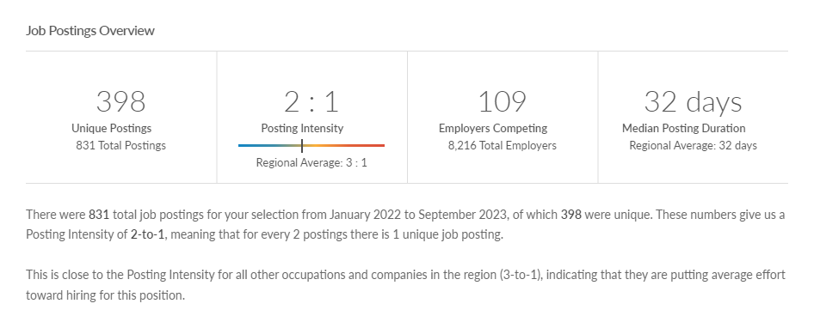
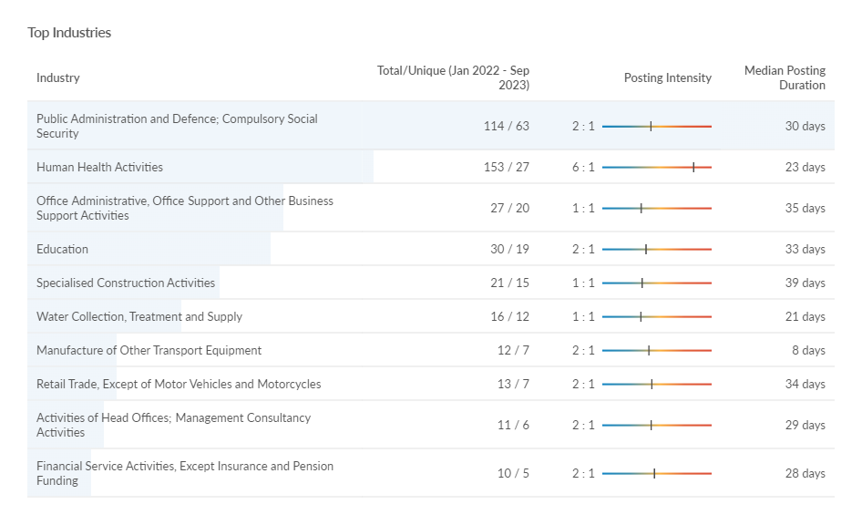
Green Job postings - volume
There c400 job postings across 2022 and 2023 (to date) based on the definition of green skills adopted. This covers a myriad of roles/jobs (c360 job titles which have been defined by Lightcast through a taxonomy which has specifically developed to reflect ‘green jobs’ or jobs that require ‘green skills’.
Typically, jobs are posted twice before being filled (posting intensity of 2:1).
Source: Lightcast, 2023

Slide 5
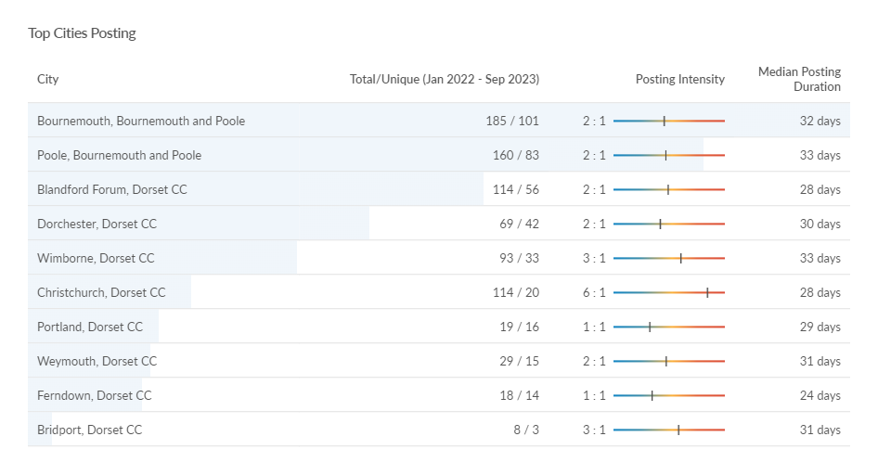
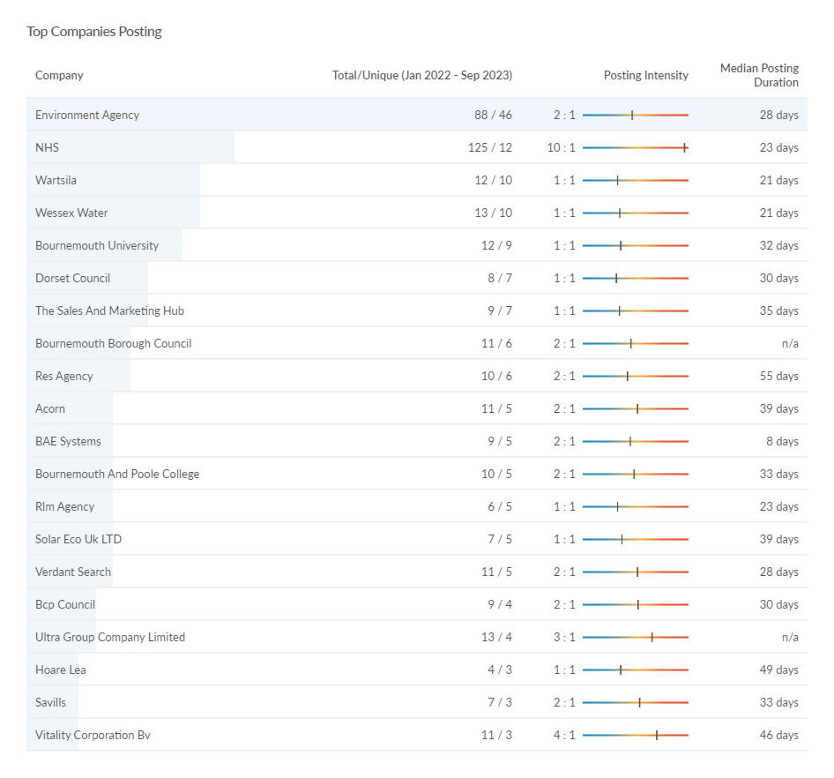
Green job postings – location and recruiters
* Christchurch is defined within Lightcast as being in the Dorset Council area – this classification does not reflect the post-April 2019 Local Government restructure
The data seems to suggest that some of the largest recruiters for jobs that have a requirement for green skills are large public sector organisations – such as those working in utilities, education and environmental management.
Source: Lightcast, 2023

Slide 6
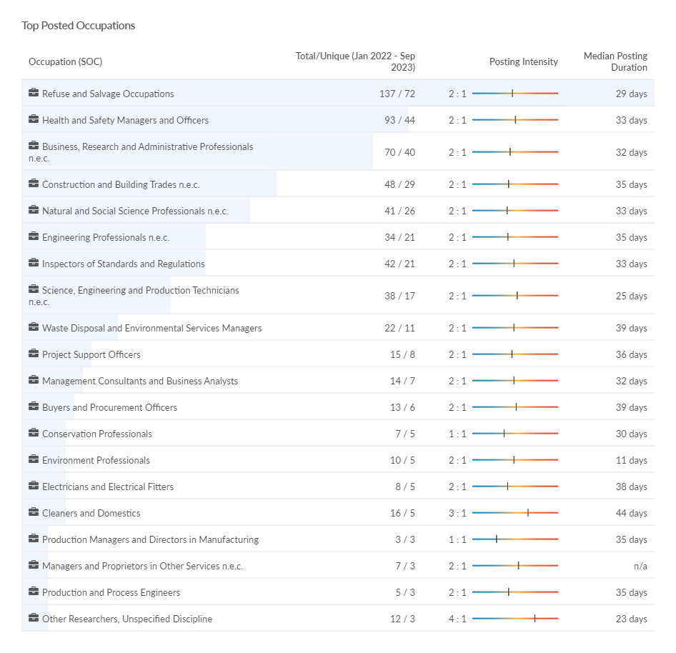
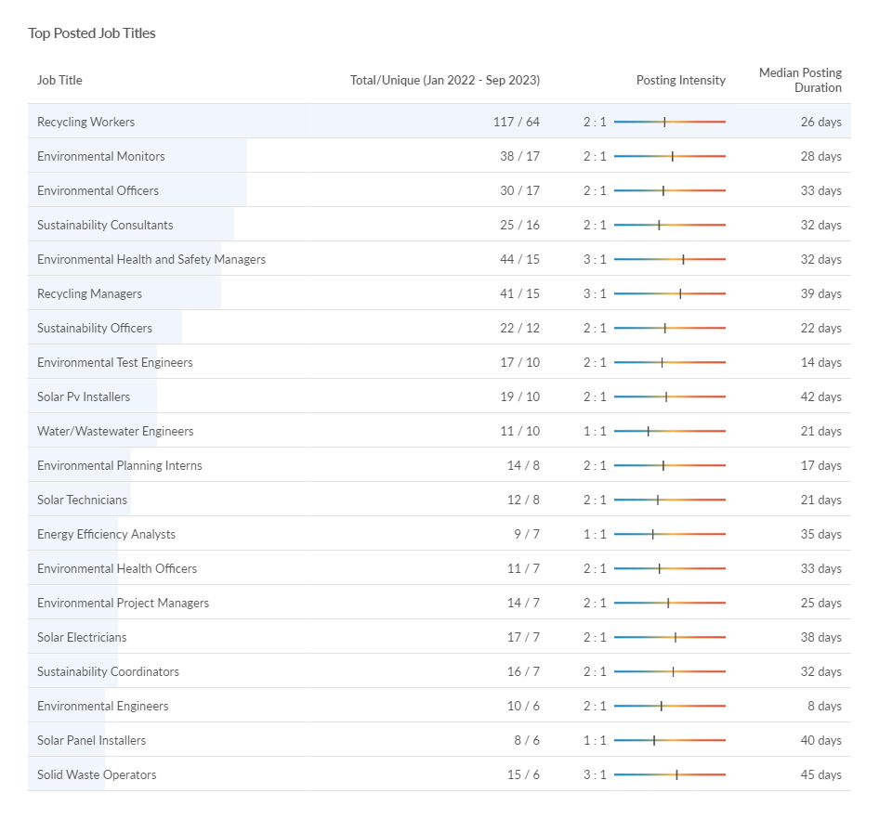
Green job postings – role demand
Source: Lightcast, 2023

Slide 7
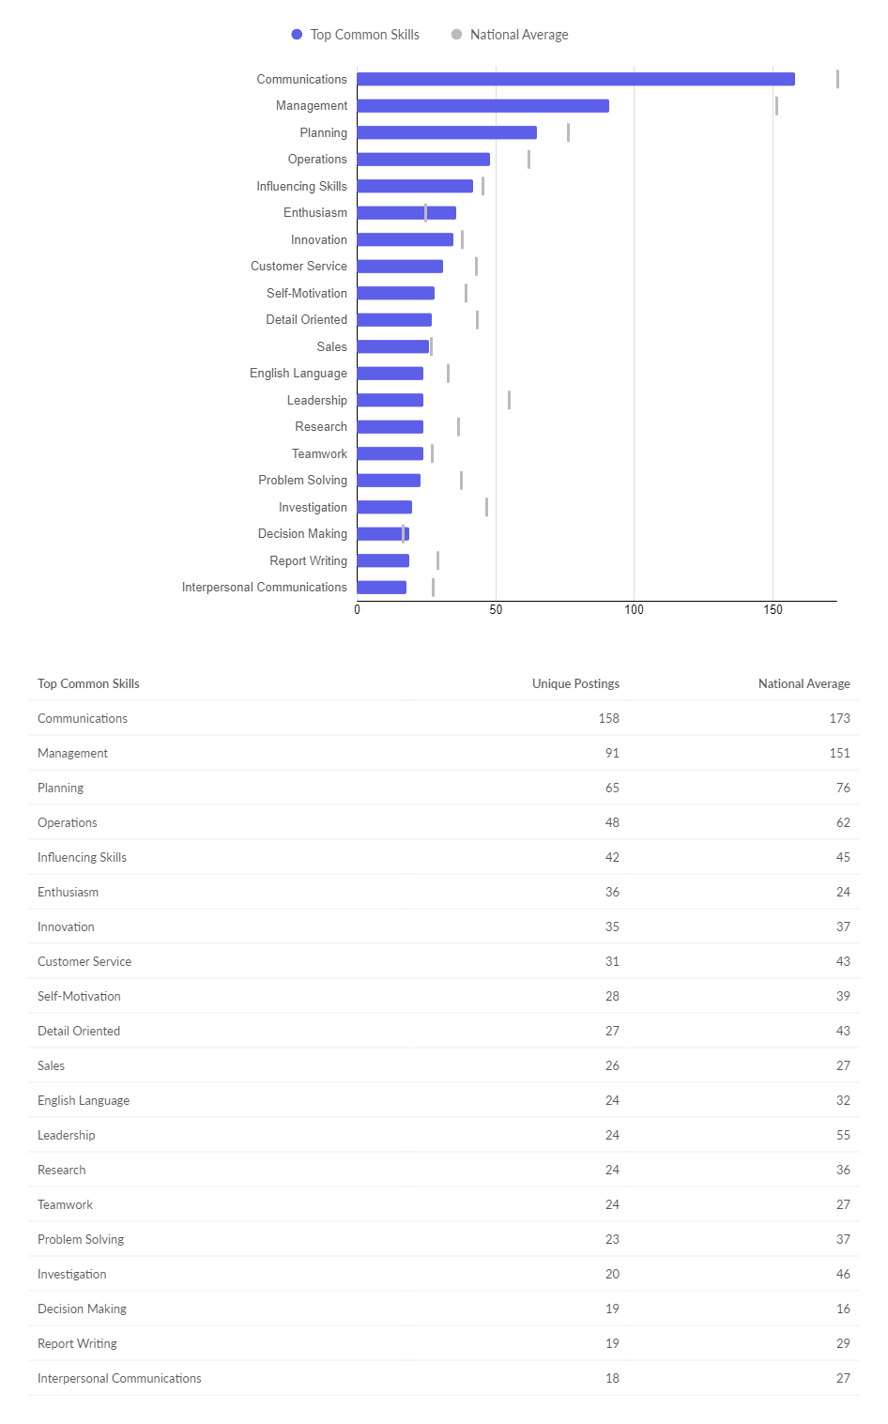
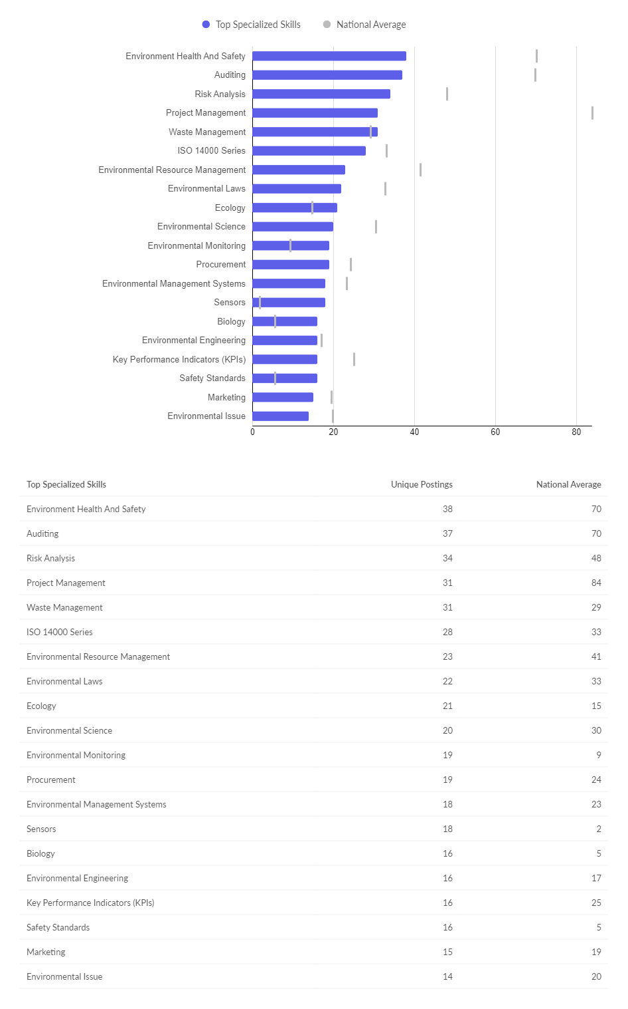
Green job postings - skills

